Slide 1
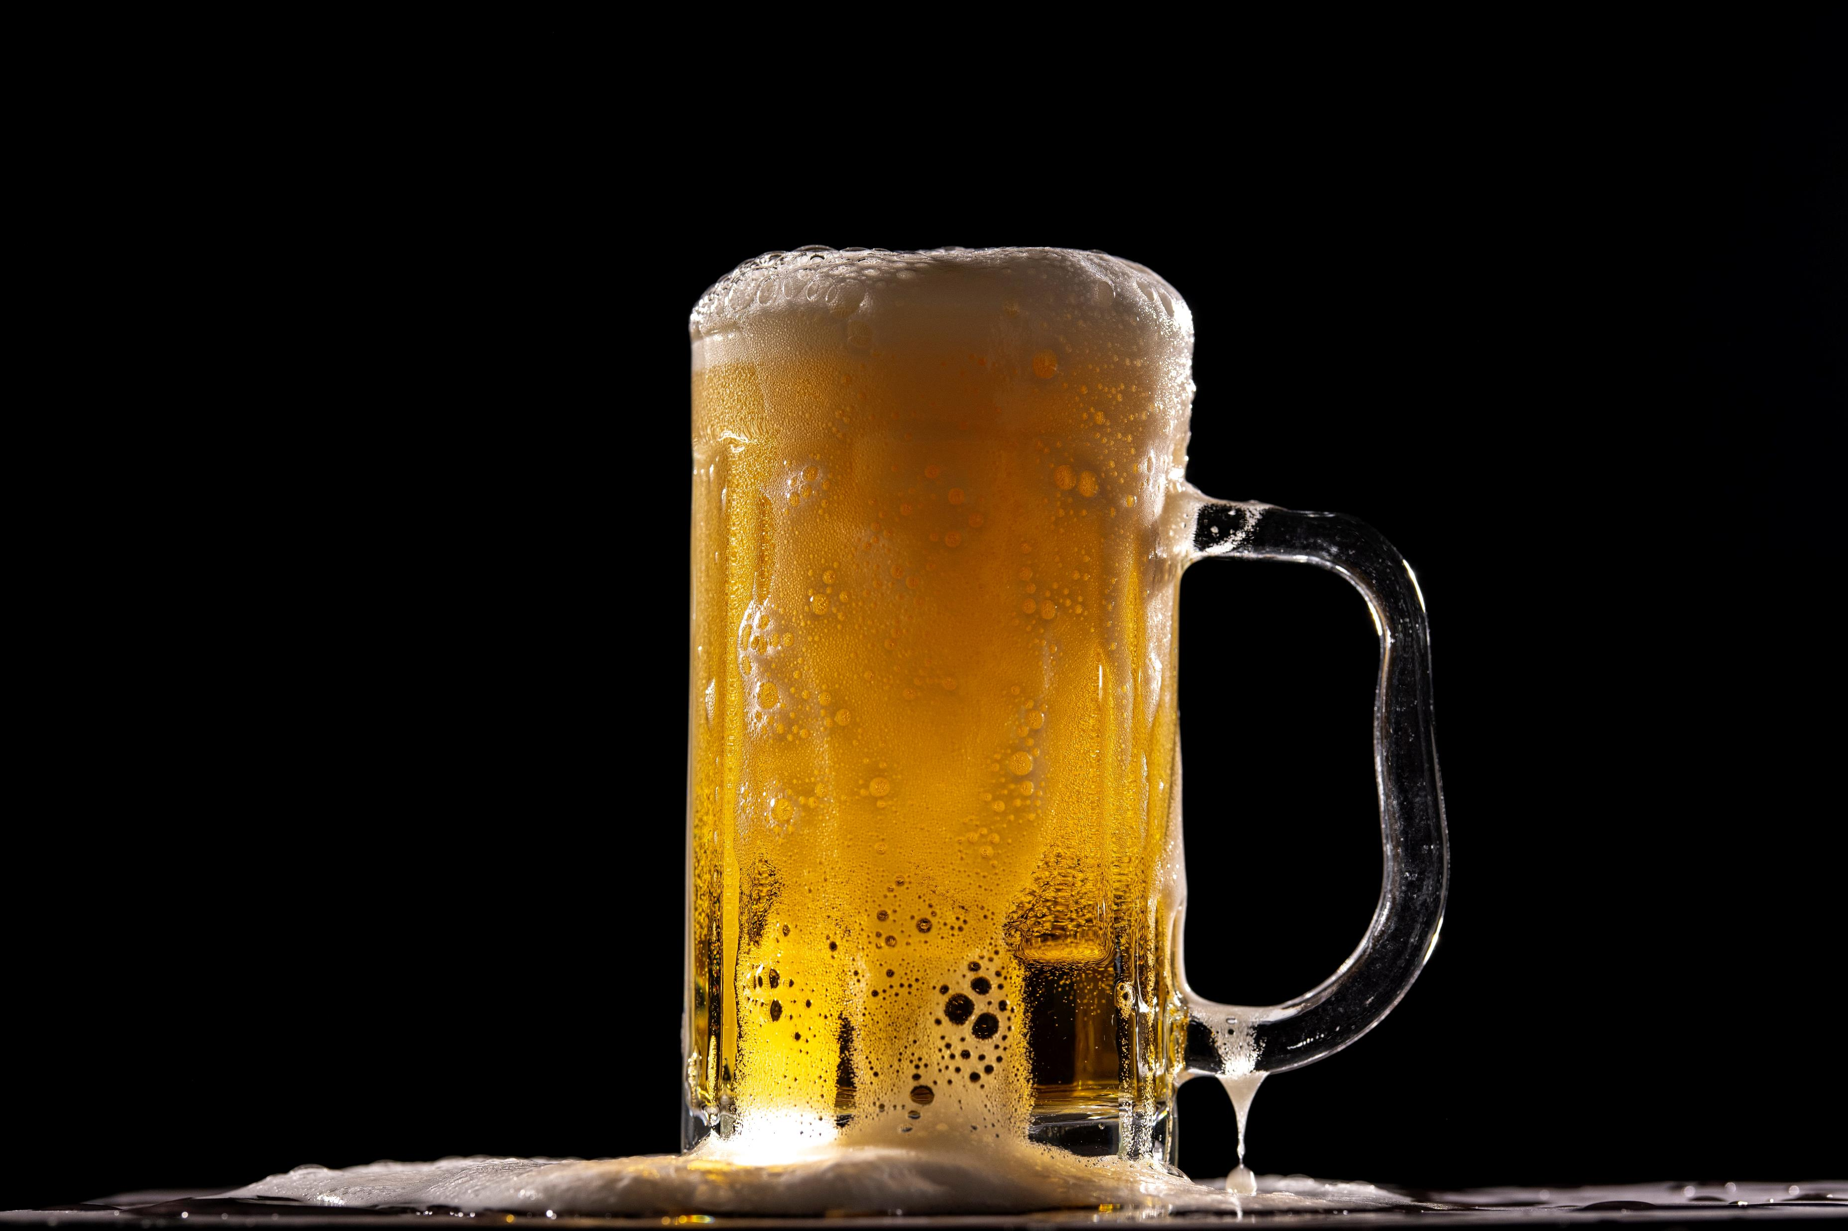
The
Beer-Commender-
System
DS004 – Anja Wittler
04.2022

Slide 2

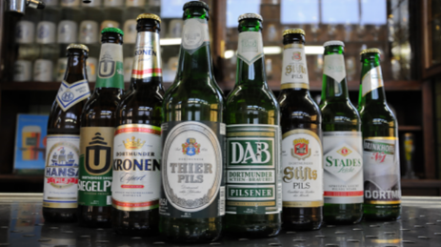
My beer …
I come from the ‘Ruhrgebiet’ and have lived many years in and close to Dortmund, a city famous for its history and variety of breweries and beer.
Beer is a strong part of the culture in this area and frankly spoken: there is nothing better on a hot summer evening.
Just that it must have a specific taste, of course. So, what if the beer garden or restaurant does not serve my preferred brand? Or if I am abroad?
Which beer should I chose?

Slide 3
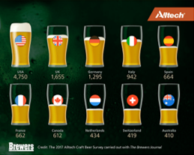
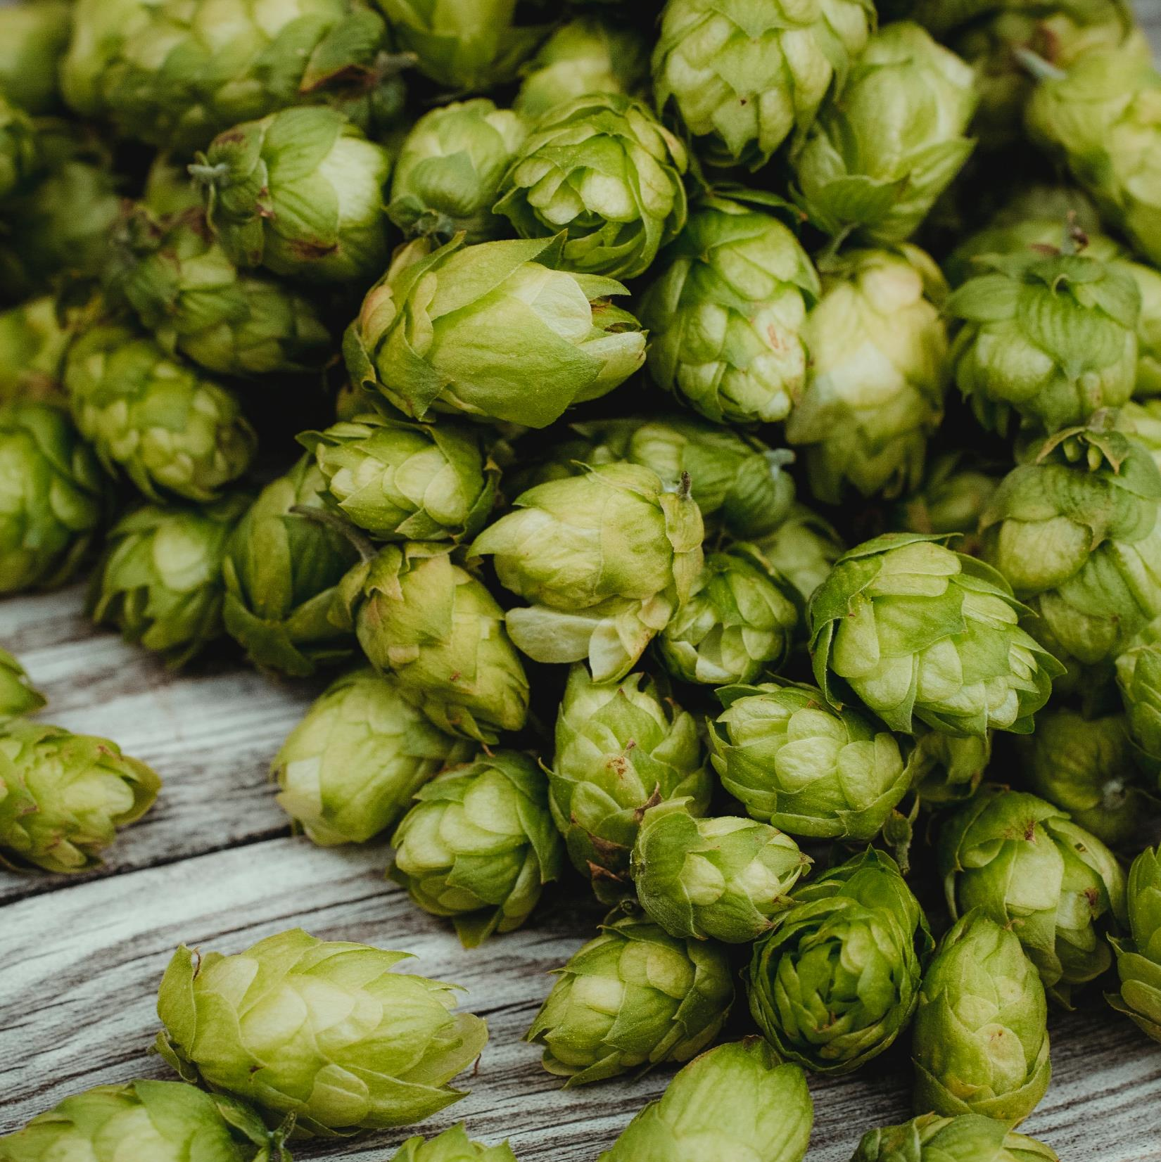
‘According to a new survey released by Alltech and The Brewers Journal, the number of breweries worldwide has surpassed 19.000, representing 209 countries and territories surveyed.’ https://www.lanereport.com/74898/2017/03/alltech-and-brewers-journal-survey-finds-94-of-worlds-19000-breweries-are-craft-u-s-has-4750/

Slide 4
Beer datasets
Beer Profile and Ratings Data Set, by ruthgn Beer Profile and Ratings Data Set | Kaggle
Based on appr. 1.5 million reviews on BeerAdvocate
< Founded in 1996, BeerAdvocate is one of the oldest and largest online communities
of beer geeks and industry professionals dedicated to supporting and promoting beer. >
Opendatasoft Open Beer Database - Breweries — Opendatasoft
for country data

Slide 5
Beer characteristics
objective / chemical
ABV, or alcohol by volume, is the standard measurement, used worldwide, to assess the strength of a particular beer. Lighter beers range from 4-4.5% ABV, with percentages getting higher with heavier styles of beer.
IBU, or international bittering unit, measures the bitterness levels in beer (based on the amount of hops added)
ABV and IBU explained (shorecraftbeer.com)

Slide 6
Beer characteristics
subjective / taste
What You (Mouth)Feel in Beer:
Body: light, medium, heavy
Carbonation: creamy, smooth, refreshing, effervescent, edgy, sharp
Aftertaste: watery, thin, light, smooth, thick, heavy, coarse, tingling, warming, astringent (dataset: astringency / body / alcohol)
What You Smell in Beer:
Yeast Scents: sweet, fruity, bread-like, buttery, caramel, spicy
Hop Scents: floral, fruity, tropical, grassy, earthy, woody, pine, sage, herbal, berry
Malt Scents: nutty, roasty, coffee, caramel, chocolate
(dataset: malty / spices / hoppy / fruits)
What You Taste in Beer:
Sweet, Bitter or Balance, Simple, Layered, Complex
Mild Beer: light, delicate, crisp, refreshing
Bold Beer: sharp, strong, intense, powerful, robust, hearty
Malty Beer: caramel, buttery, coffee, chocolate, toasted, roasted
Hoppy Beer: floral, fruity, citrusy, earthy, herbal, spicy
(dataset: salty / sour / sweet / bitter)
Homebrew Beer Astringency - Winning Homebrew (winning-homebrew.com)
Beer Characteristics (How to Talk About Beer Like A Pro!) - HOOH HOPS

Slide 7
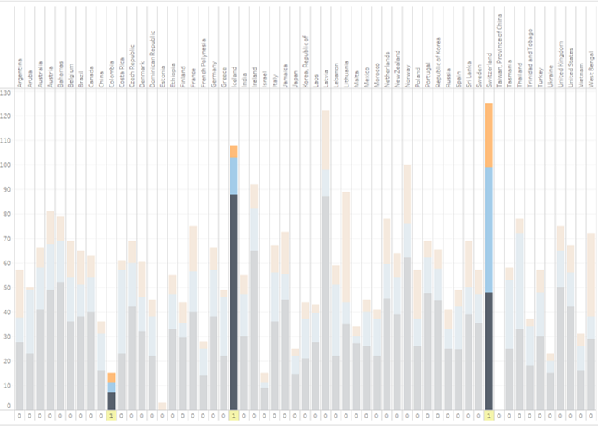
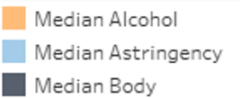
Columbia, Iceland and
Switzerland
Median rating,
defined by word counts found in reviews of each beer.
Regional difference
- ‘mouthfeel’
Alcohol
Astringency
Body

Slide 8
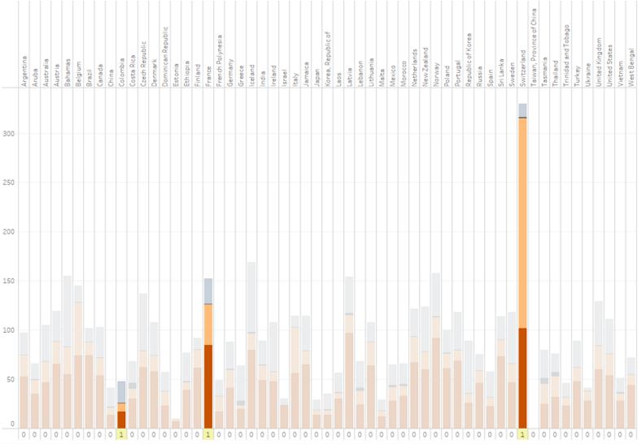
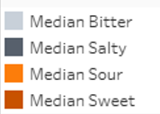
Columbia, France and Switzerland
Median rating,
defined by word counts found in reviews of each beer.
Regional difference
- ‘taste’
Bitter
Salty
Sour
Sweet

Slide 9
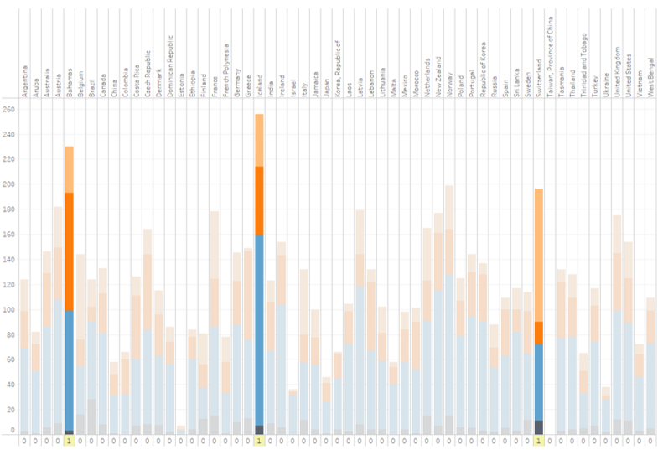
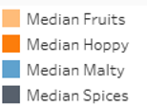
Bahamas, Iceland and
Switzerland
Median rating,
defined by word counts found in reviews of each beer.
Regional difference
- ‘flavor’
Fruits
Hoppy
Malty
Spices

Slide 10
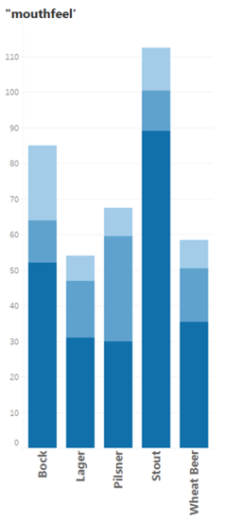
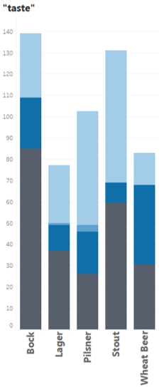
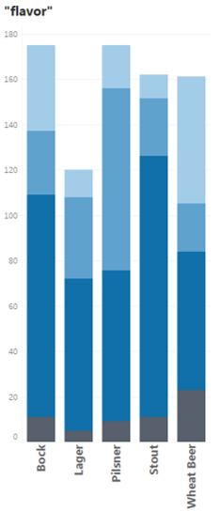
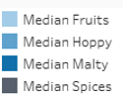
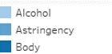
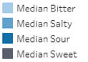
Or by style: Bock Lager Pilsner Stout Wheat Beer
Pilsner might be a better choice,
if you prefer bitterness, or Stout, if ‚maltyness‘ or sweetness is more favored.

Slide 11
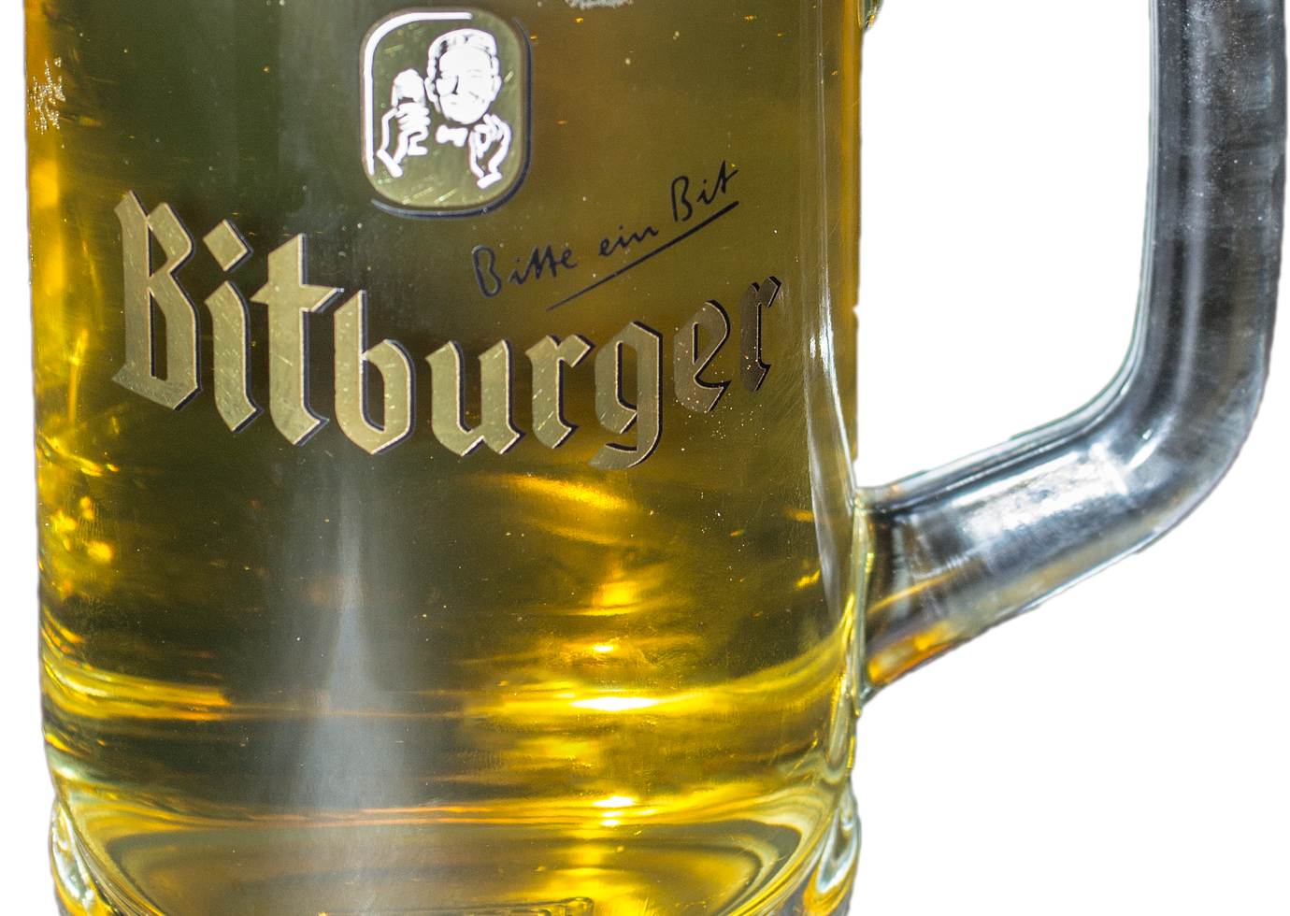
My preference:
not too bitter,
not too sweet and definitely:
no „Plörre“* …
(*Plörre: mix beer and water in equal parts,
bring to room temperature and let it sit for 2 hours…)

Slide 12
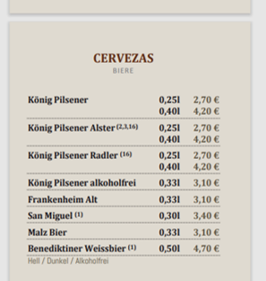
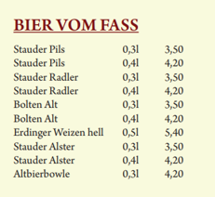
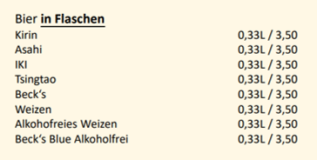
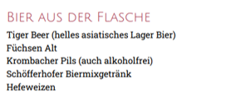
Back to the problem.. On menu cards ..

Slide 13
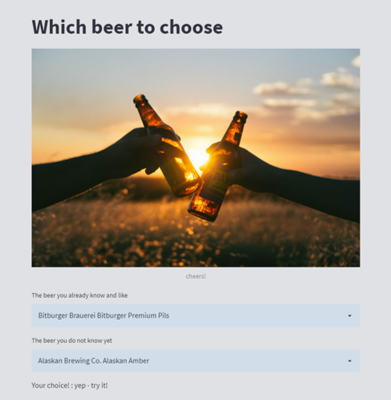
Here is the solution:
The beer-commender-system-
web-app

